Slide 1

Institute of Aeronautical Engineering
Department of Information Technology
Use of Machine Learning Algorithm for designing efficient Cybersecurity solution
Batch Members
19951A1210 - Pragnya Ambekar
19951A1219 – Bhagyashree Jena
19951A1209 - G. Akshith Kumar
Supervisor Name
Dr.Ravi Kumar Poluru
Designation: Assistant Professor
Information Technology
Date: 09/12/2021

Slide 2
OUTLINE
Abstract
Introduction
Existing solution
Drawbacks
Proposed work
Requirements
References

Slide 3
Abstract
With rapidly increment of internet traffic, the importance of cyber security also increases significantly. Several areas like IP traffic classifications, detection of - intrusion, spam and malware becomes important to be considered. To overcomes the cyber security issues traditional techniques are not enough. It is essential to adapt the ongoing changes to keep security always up to date and It can’t be denied that the web of Machine Learning keeps increasing in the digital world. In this paper we will see how several algorithms of Machine Learning can be used to overcome the popular issues faced by cyber security
KEYWORDS
Machine learning, Cyber Security, IP traffic classification, Intrusion Detection System, Malware.

Slide 4
Introduction
What is Machine Learning?
Machine Learning is the field of study that gives computers the capability to learn without being explicitly programmed.
ML is one of the most exciting technologies that one would have ever come across.
As it is evident from the name, it gives the computer that makes it more similar to humans: The ability to learn.
Image recognition and product recommendation are two of its applications

Slide 5
Introduction(contd..)
What is Cybersecurity?
Cybersecurity is the practice of protecting systems, networks, and programs from digital attacks.
These cyberattacks are usually aimed at accessing, changing, or destroying sensitive information; extorting money from users; or interrupting normal business processes.
Implementing effective cybersecurity measures is particularly challenging today because there are more devices than people, and attackers are becoming more innovative.

Slide 6
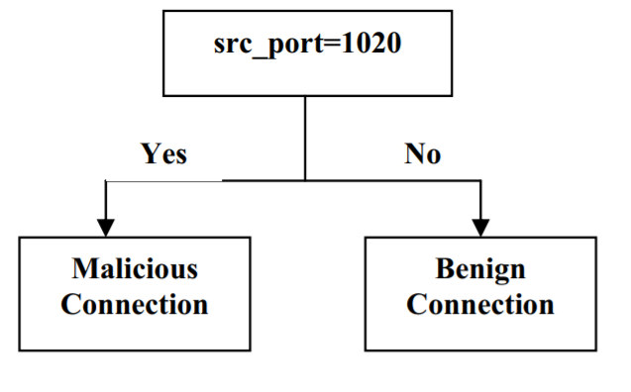
Existing System
Intrusion detection can be considered as classification problem where each connection or user is identified either as one of the attack types or normal based on some existing data. Decision trees can solve this classification problem of intrusion detection as they learn the model from the data set and can classify the new data item into one of the classes specified in the data set. Decision trees can be used as a misuse intrusion detection as they can learn a model based on the training data and can predict the future data as one of the attack types or normal based on the learned model.

Slide 7
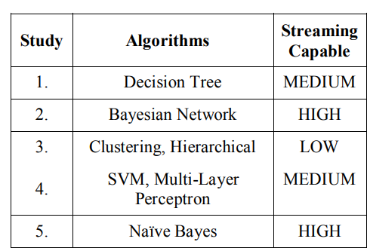
Drawbacks
Disadvantages of decision trees:
They are unstable, meaning that a small change in the data can lead to a large change in the structure of the optimal decision tree.
Streaming Capability is less
Time complexity is more

Slide 8
Proposed work
Naïve Bayes algorithm is a supervised learning algorithm, which is based on Bayes theorem and used for solving classification problems.
Naïve Bayes Classifier is one of the simple and most effective Classification algorithms which helps in building the fast machine learning models that can make quick predictions.
It is a probabilistic classifier, which means it predicts on the basis of the probability of an object.
Advantages of Naïve Bayes Classifier:
Naïve Bayes is one of the fast and easy ML algorithms to predict a class of datasets.
It can be used for Binary as well as Multi-class Classifications.
It performs well in Multi-class predictions as compared to the other Algorithms.
It is the most popular choice for text classification problems.

Slide 9
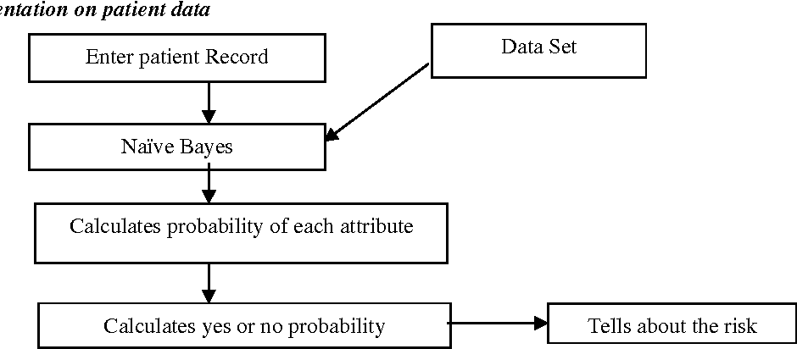
Architecture
Enter the record

Slide 10
Requirements
Hardware Requirements :
A computer with – Core i5 processor 8GB RAM 250GB hard disk.
Software Requirements :
Python programming language
Knowledge on NumPy, Pandas

Slide 11
References
https://www.javatpoint.com/applications-of-machine-learning
https://ieeexplore.ieee.org/document/8993253
https://ieeexplore.ieee.org/document/6511281
https://www.sciencedirect.com/science/article/pii/S2212017312002964

Slide 12
THANK YOU

